Slide 1


Cloud Solution Architect
Module 2
Lecture 3
Linux Directory Structure and Basic Commands

Slide 2
Recap
Module 2 - Lecture 2
Introduction to Linux (Ubuntu)
Linux Kernel
Introduction to Virtualization
Virtual Machines
Hypervisors
OS installation on Virtual Machine
Ubuntu Graphical User Interface (GUI)

Slide 3
Learning Objectives
Module 2 - Lecture 3
Introduction to Command Line Interface (CLI)
Linux Directory Structure
Linux Basic Commands

Slide 4
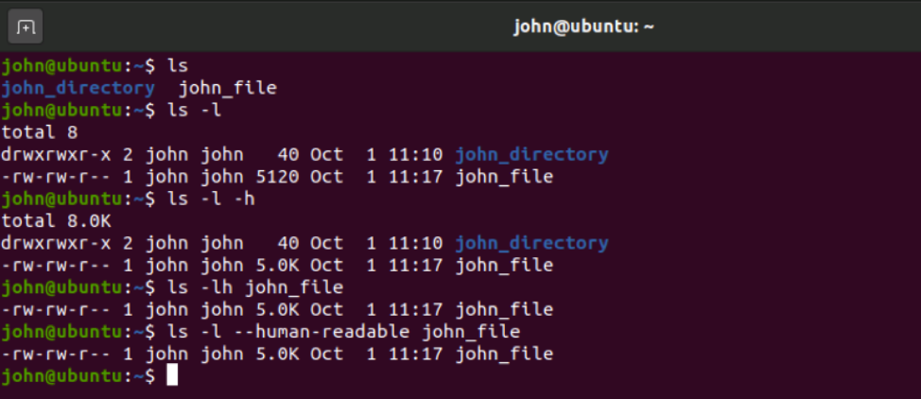
Command Line Interface
Terminal for your computer
Enable users to interact with the operating system
Takes in commands, and passes them on to the computer's operating system
Output shows the reply from the operating system

Slide 5
Linux Directory Structure
Directory
Description
/
"root" Primary hierarchy for entire file system
/bin
Essential command binaries must be available in the single-user mode for all users. e.g cat, ls
/boot
boot loader files, e.g kernels, initrd
/dev
device files, e.g /dev/sda
/etc
Editable text configuration or Extended tool chest

Slide 6
Linux Directory Structure
Directory
Description
/etc/opt
Configuration files for add-on packages stored in /opt
/home
Users' home directories, containing personal files, personal settings etc.
/lib
Essential libraries for binaries in /bin and /sbin
/media
mount point for removable media such as usb
/mnt
Temporarily mounted filesystems

Slide 7
Linux Directory Structure
Directory
Description
/opt
Optional application software packages
/proc
Virtual fs providing process and kernel as files
/root
Home directory for root user
/run
runtime variable data, currently logged-in users, running daemons etc.
/sbin
Essential system binaries e.g fsck, init, route

Slide 8
Linux Directory Structure
Directory
Description
/sys
information about devices, drivers, and some kernel features
/tmp
Temporary files, not preserved between reboot, severely size restricted
/usr
secondary hierarchy for read-only user data, majority of user utilities and applications
/usr/bin
Non-essential command binaries, for all users
/usr/include
Standard include files

Slide 9
Linux Directory Structure
Directory
Description
/usr/lib
libraries for binaries in /usr/bin and /usr/sbin
/usr/local
Tertiary hierarchy for local data, specific to this host
/usr/sbin
non-essential system binaries
/usr/share
Architecture independent data
/var
Variable Files

Slide 10
Linux Directory Structure
Directory
Description
/var/lock
Lock files. keeping track of resources currently in use
/var/tmp
temporary files to be preserved between reboots
/var/lib
State information. Persistent data modified by programs as they run e.g databases
/var/log
Log Files, Various logs
/var/run
Runtime variable data

Slide 11
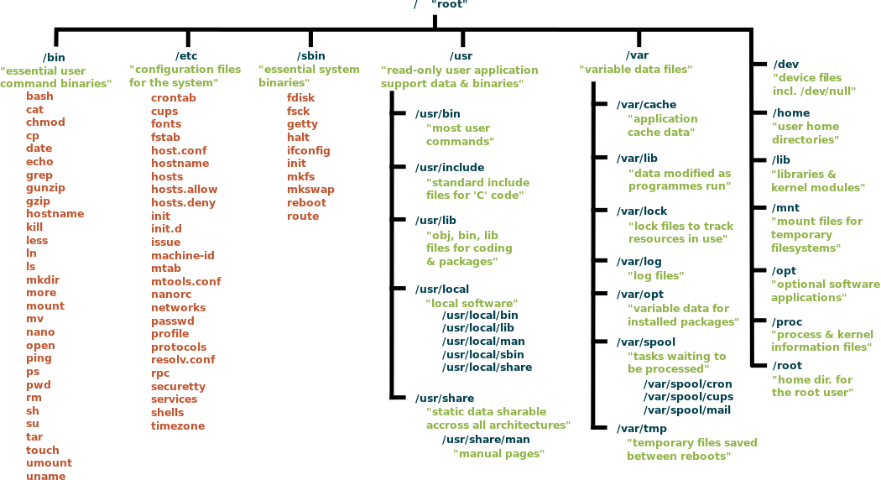

Slide 12
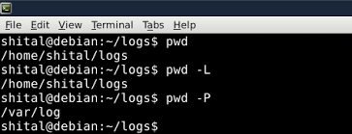
Linux Basic Commands
pwd: present working directory.

Slide 13
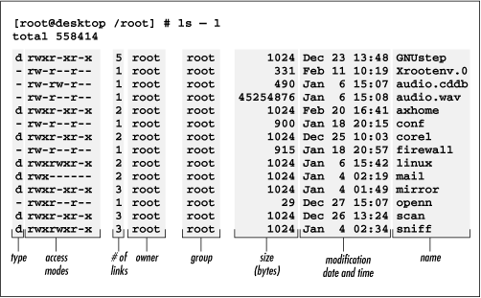
Linux Basic Commands
ls: list the files in a directory.

Slide 14
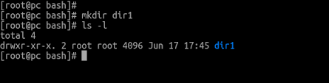
Linux Basic Commands
mkdir: make directory.

Slide 15
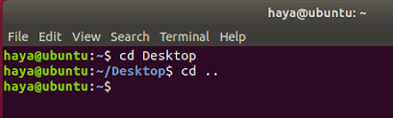
Linux Basic Commands
cd: to change directory, us 'cd' command

Slide 16
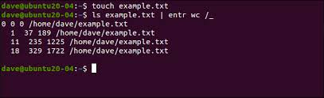
Linux Basic Commands
touch: Update the last-modified date on the given FILEs. commonly used for creating a new empty file.

Slide 17
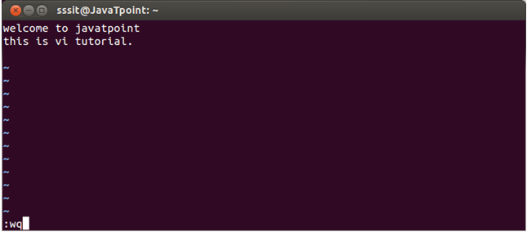
Linux Basic Commands
vi: screen-oriented text editor.

Slide 18
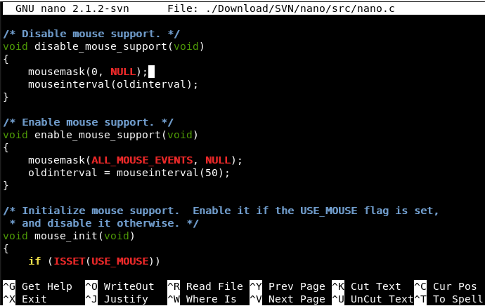
Linux Basic Commands
nano: text editor.

Slide 19
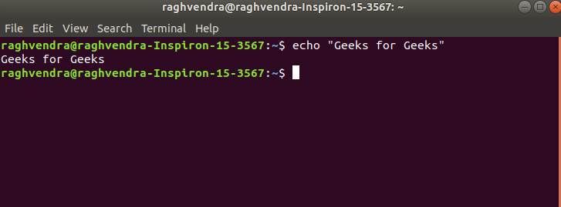
Linux Basic Commands
echo: display line of text/string.

Slide 20
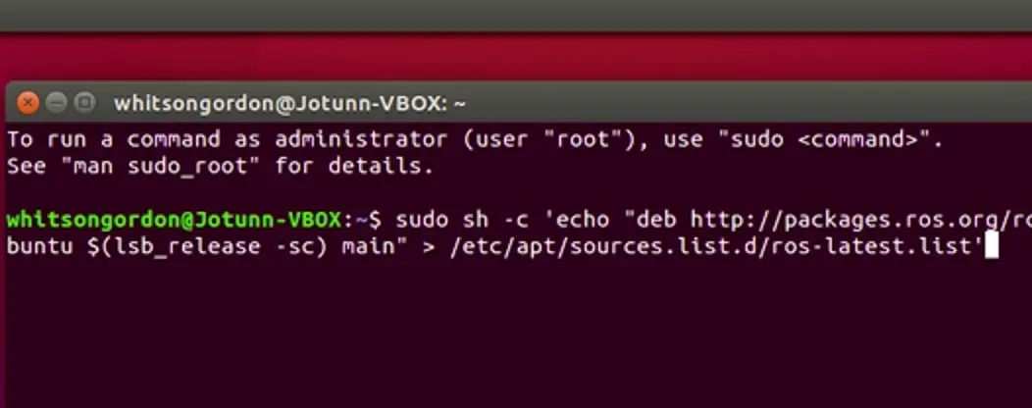
Linux Basic Commands
echo: write a line into a file using echo, write the command as
text > filename

Slide 21
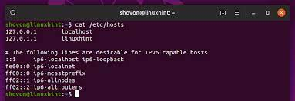
Linux Basic Commands
cat: Concatenate files and print on the standard output.

Slide 22
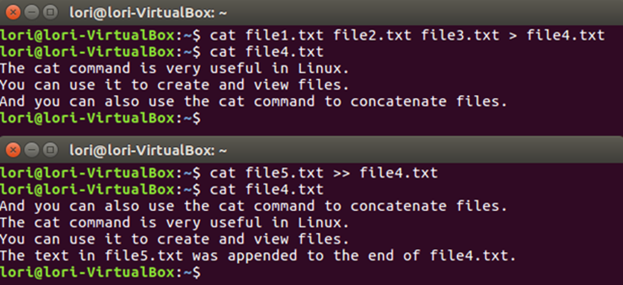
Linux Basic Commands
cat:
replace the content of a file with another file's content
(source > dest)
append the content of a file in another file
(source >> dest)

Slide 23
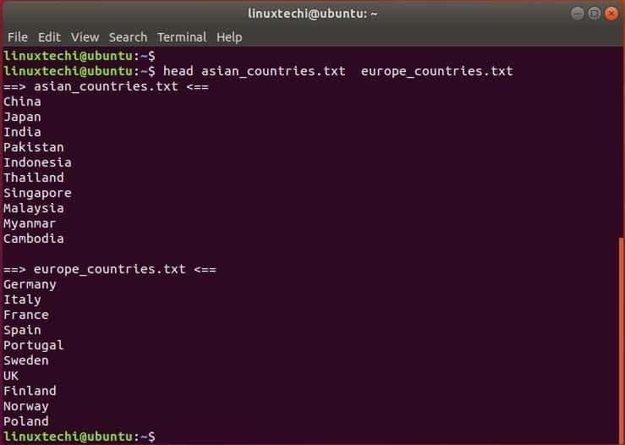
Linux Basic Commands
head: output start of a file.

Slide 24
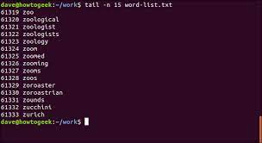
Linux Basic Commands
tail: output end of a file.

Slide 25
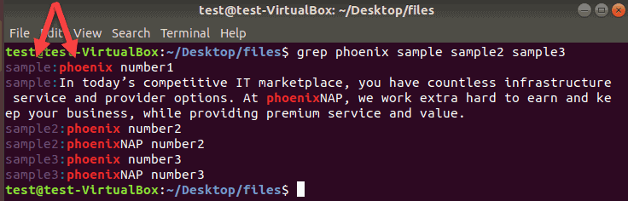
Linux Basic Commands
grep: search for a string of characters in a specified file.

Slide 26
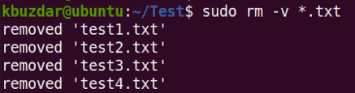
Linux Basic Commands
rm: removes each file specified.

Slide 27
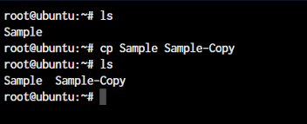
Linux Basic Commands
cp: copying files and directories to another location.

Slide 28
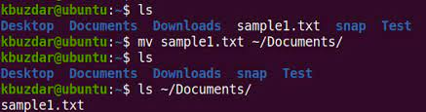
Linux Basic Commands
mv: move file or directory from one place to another.

Slide 29
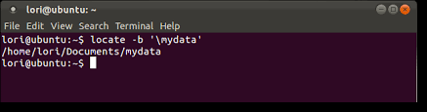
Linux Basic Commands
locate: will print the absolute path of all files and directories.

Slide 30
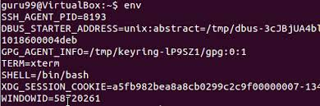
Linux Basic Commands
env: print a list of the current environment variables.

Slide 31
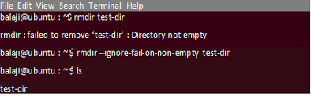
Linux Basic Commands
rmdir: Remove the DIRECTORY, if it is empty.

Slide 32
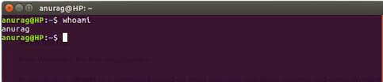
Linux Basic Commands
whoami: Print the current user name.

Slide 33
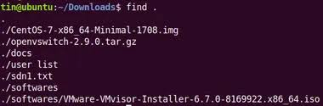
Linux Basic Commands
find: Search for files in a directory hierarchy

Slide 34
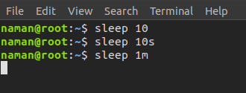
Linux Basic Commands
sleep : Delay for a specified amount of time

Slide 35
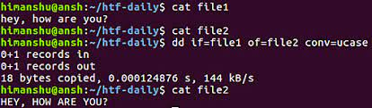
Linux Basic Commands
dd : Copy a file, converting and formatting.

Slide 36
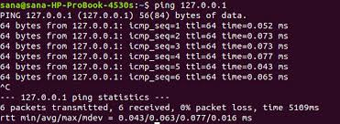
Linux Basic Commands
ping: Send ICMP ECHO_REQUEST to network hosts

Slide 37
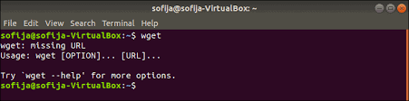
Linux Basic Commands
wget: Retrieve files via HTTP or FTP

Slide 38
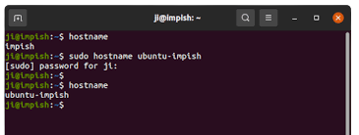
Linux Basic Commands
hostname: Get or set hostname or DNS domain name

Slide 39
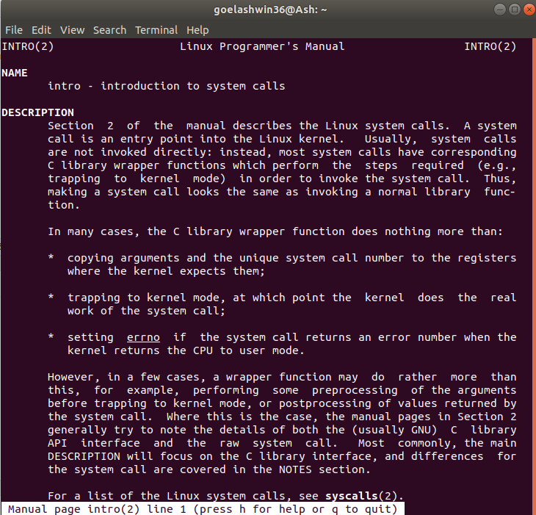
Linux Basic Commands
man: interface to the on-line reference manuals

Slide 40
Summary
Module 2 - Lecture 3
Introduction to Command Line Interface (CLI)
Linux Directory Structure
Linux Basic Commands

Slide 41
Next Lecture
Module 2 - Lecture 4
Package Manager
Public Repositories
Software installation using package manager

Slide 42

Ask Questions!!

